Slide 1
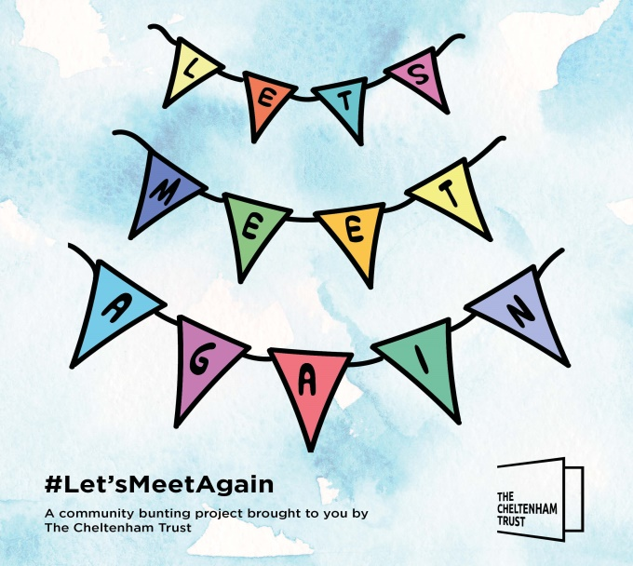
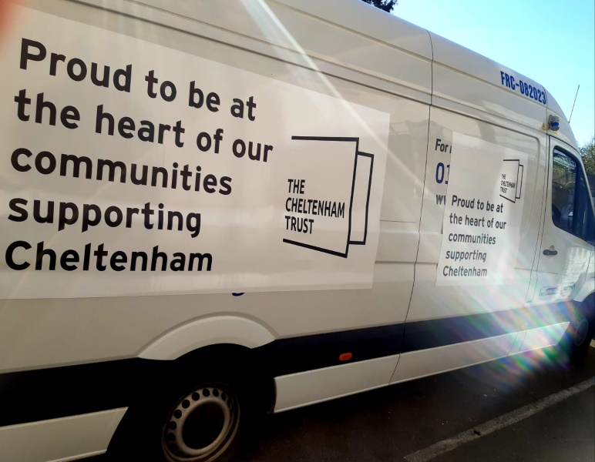
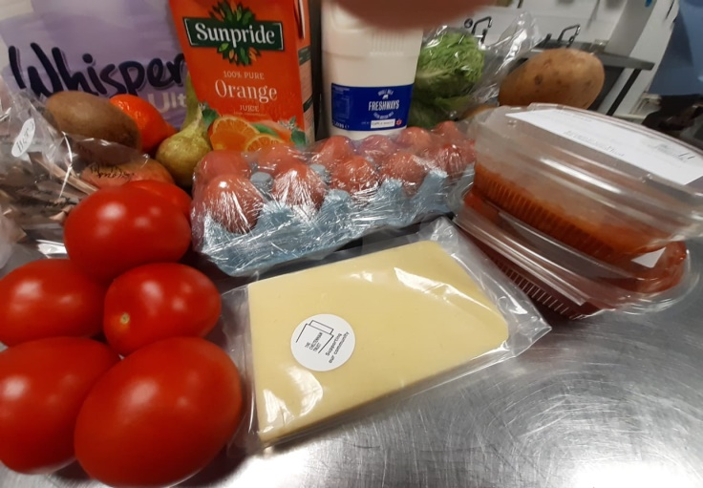
Laurie Bell CEO, The Cheltenham Trust
Now is the time to
remobilise, recover and re-build

Slide 2
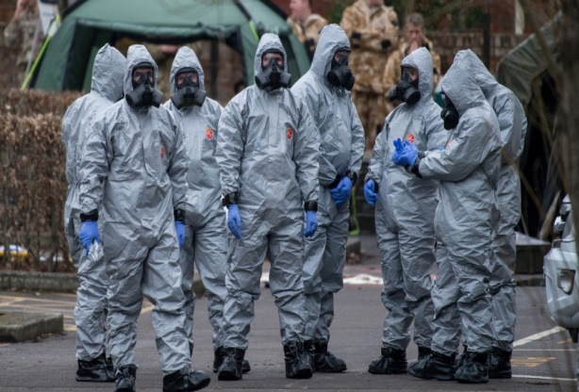
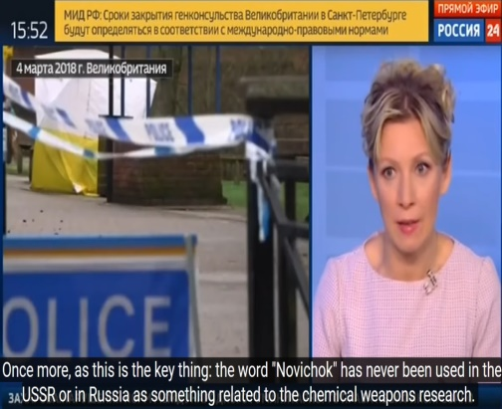
Facing the ultimate leadership test – crisis into recovery Former Director of Communities and Communications at Wiltshire Council - Laurie was the lead for communications and marketing following the nerve agent attacks in Salisbury in 2018.
Salisbury hit headlines across the world on 5 March 2018:
Public confidence and the local economy collapsed with immediate effect
Tourists and locals avoided the city and, 3 months later, neighbouring town of Amesbury
Strong and clear leadership was essential at local and national level
Intense pressure, fast moving, highly sensitive and political environment
Unprecedented situation and a huge challenge for even the strongest and most experienced leader

Slide 3
Facing another leadership test… sooner than I expected! Impact on The Cheltenham Trust
All venues closed on 17 March
Entirely reliant on income from shows, hires, catering, memberships
Cash flow impacted immediately – no reserves
Within days – furloughed 100 staff (+120 casual staff)
Realigned core team to provide a community food hub delivering meals and food parcels to most vulnerable:
More than 600 food parcels
Almost 600 meals
Retained business critical team - focus on customer contact, engagement and communication
Rescheduling shows and hires
Running campaigns and initiatives - #let’smeetagain bunting project, #humankind, #stayfitcheltenham
Virtual exhibitions – Sisterhood

Slide 4
What did I learn about leadership through this experience, and how has this learning transferred in the current pandemic?
Maintaining clear and focused leadership throughout is critical – now is the time to embed confidence and positivity
Set out your ethos as an organisation – how do you want to be seen throughout the crisis and recovery?
Vital to maintain your relationship with all stakeholders
Think strategically – always - even when you're in the thick of operational actions
Look ahead - vision and direction – and plan
Recognise opportunities – be agile and move at pace
Monitor public and employee sentiment and respond
Always respond – never react
Communicate, communicate, communicate
Tackle challenges head on
Manage resilience and endurance
You are the role model…

Slide 5
Making the shift towards remobilise, recover and rebuild The ability to vision, plan, focus and deliver
Be visionary - always see the art of the possible
Know the reality - what can change and improve
Don’t assume BAU is good enough – now’s the time to rebuild something better
Review your learning throughout the crisis – use this!
Develop a plan based on:
The facts (knowns and guidance)
Feedback (sentiment and confidence)
Your learning
Question the culture for your organisation as part of recovery and rebuilding – the how you will do things going forward?
Look at your stars – who shone in the crisis?
Leadership is about people and communities and collectively what can be achieved
Working in isolation is a high risk strategy
Recovery will take time – adopt a phased and planned approach

Slide 6
Leadership is about people and communities and resilience…
You have a powerful role in rebuilding confidence
Establish your vision and plan – the next 12 -24 Months will be rebuilding and recovering
Review and revise your plan, as needs to be agile
Your success will be based on your relationships
Communicate, engage, involve and partner
Harness energy, ideas and creativity
Be agile – new ways of working and new opportunities will emerge
There will be a new normal – what’s yours?
Stay positive and focused and,
Be the role model

Slide 7
Key questions…
What’s your vision for the next 12 -24 years?
What’s your plan focused on and what’s your phased approach?
What’s your success measures?
How is your success reliant on others?
What’s your strategy for communication and engagement?
What’s your new normal?
How are you role modelling leadership with your people and community?

Slide 8
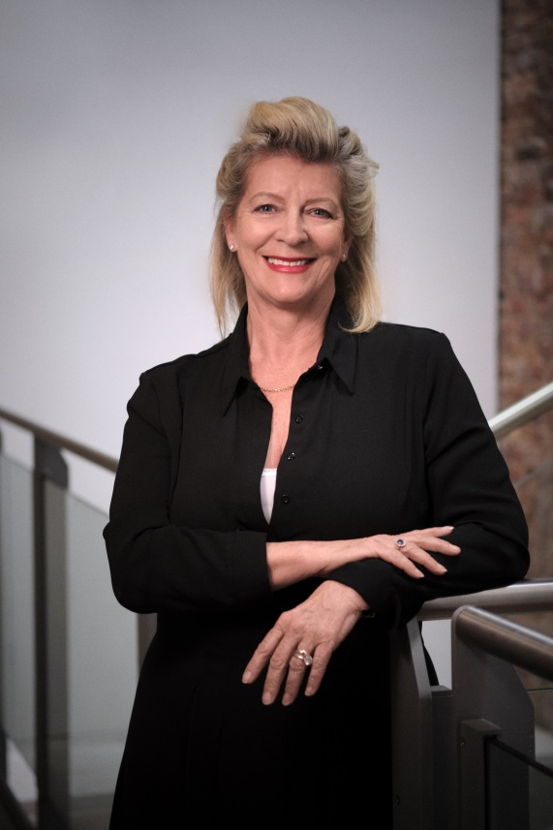
Laurie Bell CEO The Cheltenham Trust The Wilson, Clarence Street Cheltenham GL50 3JT email: laurie.bell@cheltenhamtrust.org.uk Mobile 07733 307417

