Slide 1
C2S - HR Focus
Employee Benefits
29.05.2024

Slide 2
Sickness in the workplace
57% increase in sick leave since 2019, rising year on year.
Most common short-term illnesses relate to general health.
Most common long-term illnesses relate to stress, mental ill-health, musculoskeletal injuries and acute medical conditions.

Slide 3
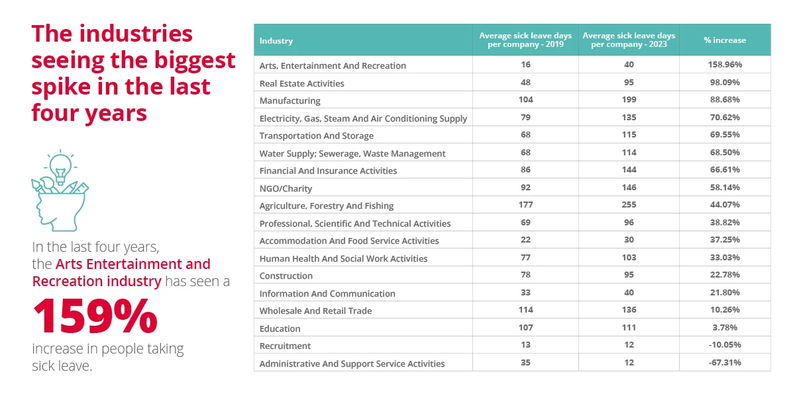
Absence by industry

Slide 4
Employee Benefits – Why?
Attracting and retaining top talent – 64% of prospects consider roles that include employee benefits.
Improved employee engagement.
Enhancing employee loyalty – 78% of employees are more likely to stay if they are part of a benefits programme.
Job satisfaction – 71% of employees surveyed felt that their employer cared about their mental health and overall wellbeing.

Slide 5
Types of employee benefits
Health & Wellness
Health insurance, Dental insurance, Optical cover, Employee Assistance Programmes, Wellness programmes, Gym memberships/reimbursements.
Financial & Retirement
Bonuses, share options, holiday pay, annual leave purchase options, employer contributed pension schemes.
Work-life Balance
Flexible working hours, work from home options, reduced working week.

Slide 6
E.a.p’s and private medical insurance
Employee Assistance Programmes
Programmes designed to help assist employees in many areas from mental health therapy, financial guidance, stress counselling, life and leadership coaching, work health assessments and relationship management.
Benefits:
56% reduction in anxiety
53% reduction in depression
45% reduction in absenteeism
44% back in work after therapy
Private Medical Insurance
Policies that will provide your employees a fast and effective route to diagnosis, treatment and recovery from medical conditions that may arise.
Benefits:
Staff back to work quicker after illness
Staff retention
Attracting and retaining top talent

Slide 7
THANK YOU
Connor Harries
Head of Employee Benefits
+44 7513 134905
connor@switchhealth.co.uk
www.switchhealth.co.uk

