Slide 1
GOLDEN VALLEY
GOLDENVALLEYUK.COM
Notes:
Apologies PM
Growing pipeline: GV and Affordable. HSR, Commercial development (MX)
Focus GV – why involved and what doing
Me – council as developer. HBD. Plexal

Slide 2
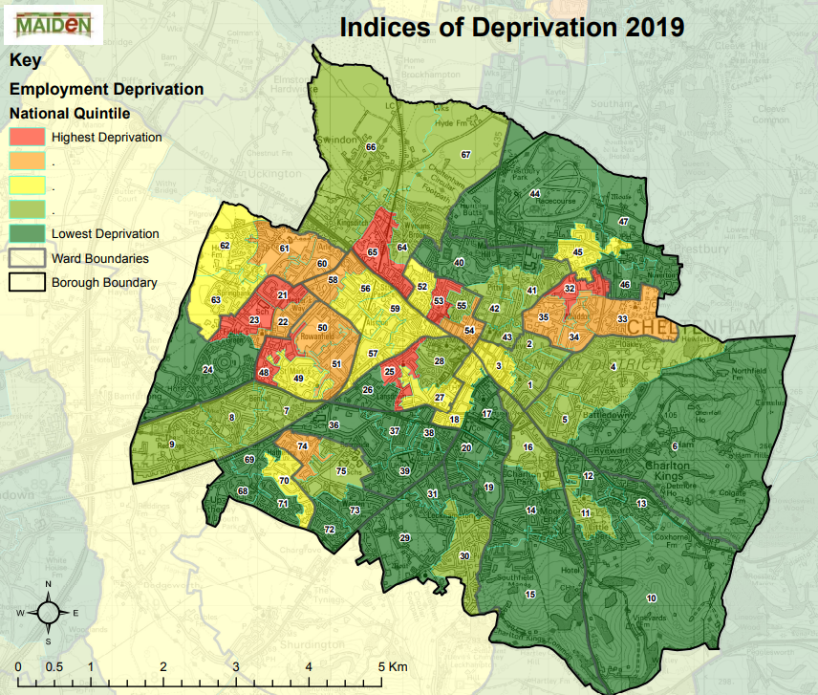
Setting the scene
Key challenges include:
- Pockets of deprivation in West Cheltenham
- Aging stock of employment buildings
- High house prices
- Insufficient Affordable Housing
- Heavy reliance on govt jobs
- Poor retention of young people
- Addressing climate change
Notes:
Context – understand why important
Cheltenham is great place.
But – have no complacency and strive to make it better.
To do this need to recognise challenges
Contained in policy documents.
List challenges
GROWTH. housing stock, jobs, economy.

Slide 3
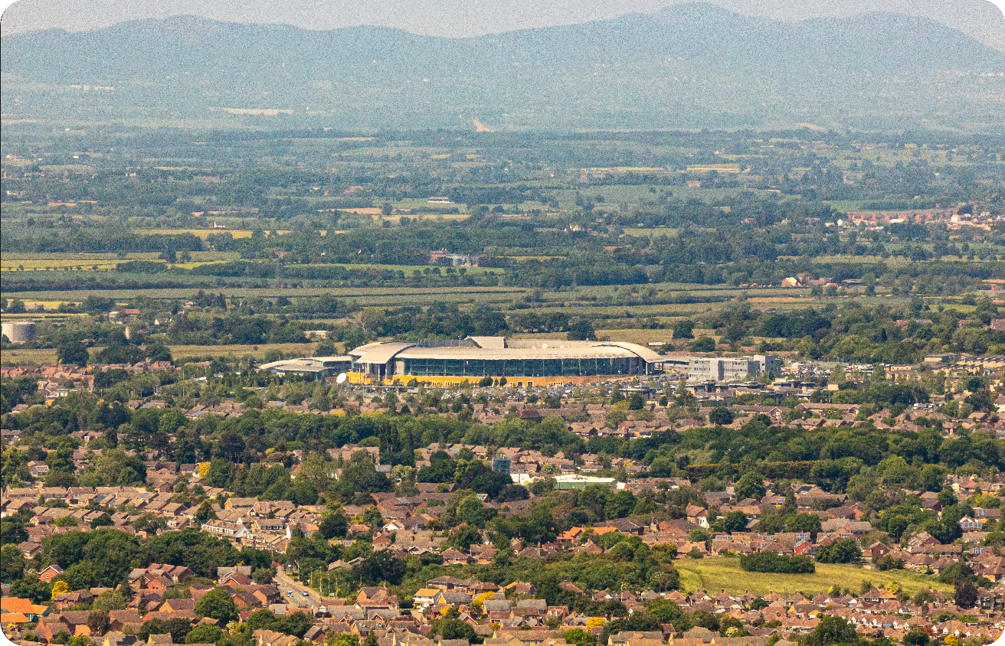
A Heritage of Invention
GCHQ has been present in Cheltenham since 1951, developing pioneering technologies in communications, intelligence and cyber security. Their presence has enabled the growth of a targeted and specialised community focused on cyber security and adjacent domains.
The technology ecosystem now present in the region covers defence, aerospace, national security and intelligence, communications, and critical infrastructure.
In Golden Valley, we can develop this strong foundation into a diverse group of organisations in academia, large industry and Startups, covering these sectors and other adjacent areas.
Notes:
Also understand history and what we do.
Strong heritage of invention and innovation.
HQ been here since 1951 - building an ecosystem of govt expertise
Recent years led to development largest cyber-security cluster outside of London
Other key strengths including defence, aerospace, national security, intelligence, communications and critical infrastrucuture.
Very strong foundation for us to build.

Slide 4
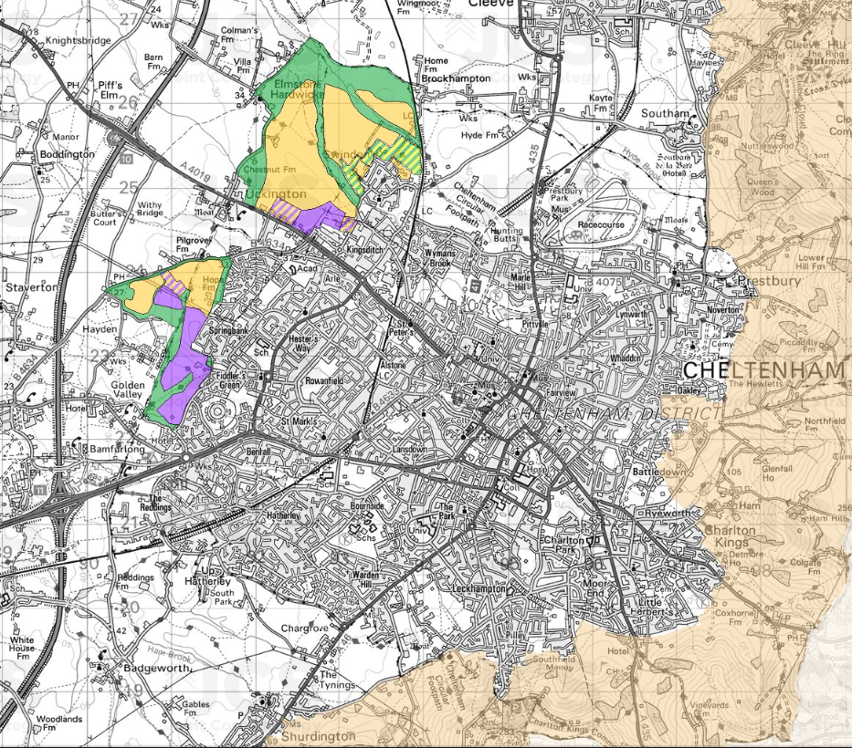
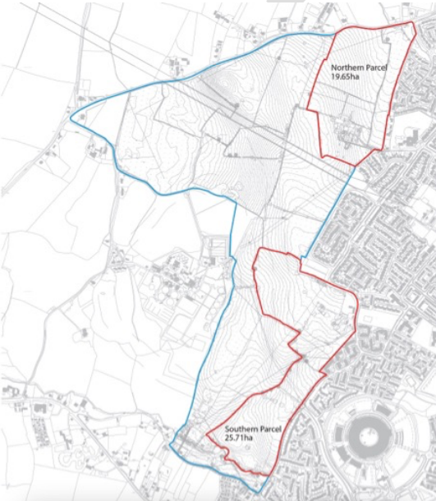
The opportunity
Golden Valley is at a critical intersection:
- Neighbours deprived communities
- Principal area designated for employment
- Adjacent to major employer
It will play a pivotal role in determining future growth within the town
Notes:
What’s the fuss about Golden Valley?
Growth physically constrained – notably the AONB
Planner focus on 2 big allocations
Colours indicated the intended uses for the land – green open space, yellow housing, purple is employment land
If consider this map in context of the challenges that I outlined earlier, the importance of Golden Valley (West Cheltenham) quickly becomes evident:
- list on slide

Slide 5
A Technology Cluster Tackling the UK’s Mission Critical Challenges
Using security as an underpinning principle for developing pioneering technologies, Golden Valley will expand the current Cheltenham community and build new institutions for
best-in-class research and development.
1 MILLION SQ FT
1000+ HOMES
SUSTAINABLE LANDSCAPE
Notes:
What is our vision?
- campus styles technology cluster – jobs for tomorrow but building on our heritage and complementary to the work already go in the town
- new homes, including Affordable housing
- Garden Community principles – high levels of design, sustainability, open space
huge challenge.
highly competitive environment. Need to be able to differentiate ourselves from other places.

Slide 6
Securing Our Future
NATIONAL SECURITY INTERNET SECURITY CYBER SECURITY BIO SECURITY HUMAN SECURITY CLIMATE SECURITY FOOD SECURITY
AI SECURITY
INFRASTRUCTURE
SECURITY
Bringing together Industry, Academia, Government and Startups in Golden Valley.
A collaborative innovation ecosystem when inquisitive minds, product builders and the architects of our future are brought together to drive extraordinary outcomes.
A call to action to the world’s innovators to use security as a foundational principle for all technology.
A transformation moment to enable super- normal progress for society, the economy and technology.
Universities
Innovation Centre
Government Labs
Product Centres
Regional HQs
Programmed Events
Cultural Institution
Skills Academies
Research Centres
Think Tank
Notes:
Industry engagement to refine vison.
Called it ‘securing our future’. A tech campus focused on tacking the UK’s Mission Critical challenges. Yes, Cyber Security will rightly be a fundamental pillar of this vison but it expands the focus.
- Building on our heritage
- Creating high skilled jobs that will be needed in the future
- Providing opportunities for our young people
- Diversifying the economy by bringing in other industries
- Focusing innovation such that new companies will develop and grow here
- Providing an environment where companies can thrive
How are we going to do that?
Creating a unique offering that business want and is sustainable in the long-term. We do that through focusing on a number of key offers:

Slide 7
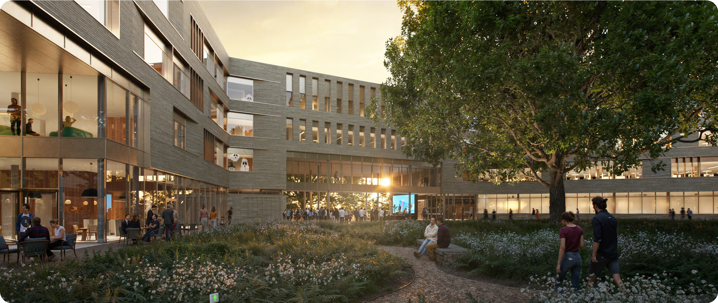
National Cyber Innovation Centre
160,000 sq.ft. (GIA)
Grade A office - NABERS 5.5*
+ BREEAM Excellent
Event, Meeting, & Collaboration space
Clustering industry, academia, and government Startups under one roof
Notes:
First building will be the NCIC – 160k, grade a, highly sustainable office space.
Purpose is to drive innovation through collaboration. It will be a space that brings together industry, academia and SME’s through workspace, programmes, events, collaboration space.
It will be the heartbeat of the development.
£20m and MOU signed
Let’s get away from the hype for a second – how and when – still a lot to do.
- outline applications submitted
- RM to come later in the year
- started the process of procuring a building contractor
- Construction to start within next 12 months

Slide 8
Forthcoming opportunities
Buildings 2 + 3
Next two buildings will be C.190,000 sq.ft. including a variety of prospective uses:
National skills development centre
Secure data environments
AI hub
Wet/dry labs
Extending your capability into a world- leading cluster for security and resilience
Notes:
What’s next?
HBD working up proposals for the next two buildings. Still at a very early stage but coming forward hot on heals of innovation centre

Slide 9
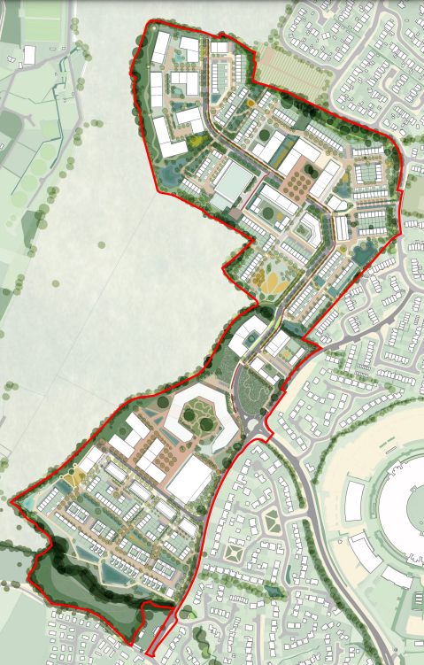
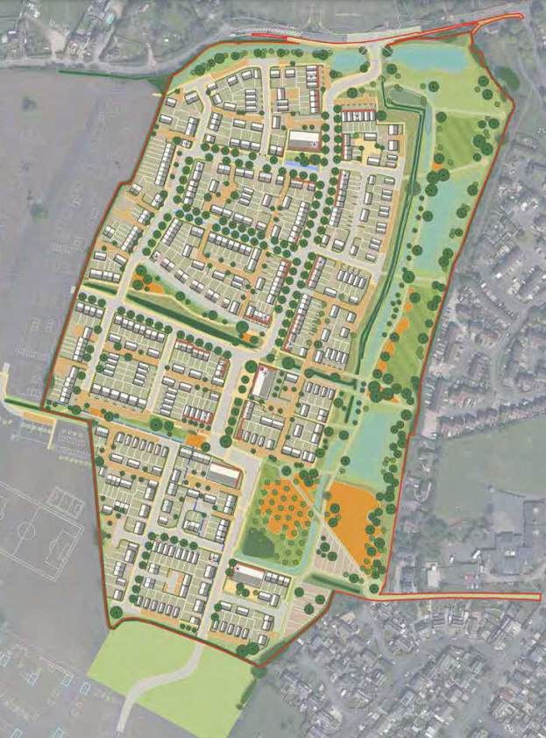
Forthcoming opportunities
Residential disposals
Residential sales parcels will be brought to market principally as packaged lots for disposal.
Notes:
Council and HBD will be bringing to market residential lots for development once Outline Planning has been obtained.

Slide 10
Questions
GOLDENVALLEYUK.COM
Notes:
Apologies PM
Growing pipeline: GV and Affordable. HSR, Commercial development (MX)
Focus GV – why involved and what doing
Me – council as developer. HBD. Plexal

