Slide 1
Build a Bear
Sustainability Update
21 June 2024

Slide 2
Regulatory horizon scan
Current
The UK Department for Trade & Business (DBT) existing disclosure requirements for large private companies (500 staff, £500m turnover) since 2022 are based on TCFD principles – governance, strategy, risk management, and metrics and targets.
Smaller organisations are required to provide SECR (Streamlined Environment and Climate Reports) and ESOS (Energy Saving Opportunity Scheme) disclosures.
IFRS
The IFRS framework outlines how organisations should report across E, S, and G. IFRS S1 and IFRS S2 are focused on climate risks and impacts and take over from TCFD work.
UK adoption has been delayed to Q1 2025 by the DBT but the scope will now be wider to include TPT.
We anticipate the reporting threshold being lower than for TCFD.
OTHER
Other environment-related disclosures are emerging:
TPT - Transition Plan Taskforce, UK Treasury backed forum which published recommendations in October 2023, expected to be adopted alongside IFRS.
TNFD – the Task Force on Nature-Related Financial Disclosures, currently seen as voluntary but in line with EU requirements.

Slide 3
Commercial considerations - Sustainability strategy
Develop sustainability action plan
Debate sustainability ‘Ambition’ and refine action plan
Formalise and communicate Sustainability Strategy
Undertake Materiality Assessment
Agree priority sustainability issues

Slide 4
Where does Crowe stand?

Slide 5
Our sustainability credentials (1/2)
We aim to deliver on our commitment and keep track of our development across the following elements:
Our Commitment
At Crowe, we are committed to building a professional services firm focused on sustainability. We do this by setting out a strategic plan that takes the longer-term view to delivering real benefits and outcomes for our people and our clients.
We play our part in building an inclusive, sustainable, and resilient future for people and the planet through our values which encompass elements that are interconnected and crucial for the wellbeing of individuals and societies including:
economic growth | social inclusion | environmental protection
As part of our internal governance, we have in place a series of sustainability-related policies and documents, including:
Sustainability Policy – What sustainability means to us and why it is important;
Sustainability Strategy – Our priorities and commitments over the next 24 months;
Supplier Code of Conduct – Ensuring ethical business practices of our suppliers and supply chain.
People
Environment
Clients
Our approach to Equality, Diversity & Inclusion
Our goal is to build a diverse, inclusive, and empowered workforce. We ensure our people continue to improve their skill set, remain ready for the future and aim to create a genuinely inclusive and respectful culture that promotes wellbeing both in and out of work.
Our firmwide approach to Equality, Diversity & Inclusion (ED&I) is to:
Create a truly inclusive organisation and celebrate the benefits that diverse teams bring us, as a firm, and as individuals. We believe more diverse teams make better decisions for our clients and our business. We each have much to bring, much to learn, and much to give.
Eliminate discrimination, harassment, and victimisation for all our people, as well as the wider communities we work with, advance equality of opportunity, tackle prejudice, and promote understanding and education.
We achieve our objectives through our ED&I communities, including Women’s Empowerment Programme,
LGBTQ+, REACH (Race, Ethnicity and Cultural Heritage), and CAN (Crowe Ability Network).
Supply Chain
Community
Governance
Disclosures
© 2023 Crowe U.K. LLP
Find out more about our sustainability journey on our website.

Slide 6
Our sustainability credentials (2/2)
We aim to deliver on our commitment and keep track of our development across the following elements:
Our environmental performance
We take our environmental performance very seriously through the following actions:
• committing to reduce our carbon footprint in line with our Science Based Targets initiative emission reduction targets;
• reducing our waste and landfill by encouraging recycling and reuse;
• ensuring environmental and energy efficiency issues are addressed during procurement and office selection;
• seeking to ensure all our people are aware of and educated to understand, the impact of their activities on the environment.
People
Environment
Our SBTi and emissions commitment
The Science Based Targets initiative (SBTi) has approved Crowe UK’s near-term science-based emissions reduction target.
Crowe UK commits to reduce absolute scope 1 and 2 GHG emissions 50% by FY2030 from a FY2020 base year.
The SBTi commends our 1.5°C-aligned target, currently the most ambitious designation available through the SBTi process.
Crowe UK also commits to reduce absolute scope 3 GHG emissions from purchased goods and services, business travel, and employee commuting 25% by FY2030 from a FY2020 base year.
Clients
Supply Chain
Community
Governance
Disclosures
© 2023 Crowe U.K. LLP
Find out more about our sustainability journey on our website.

Slide 7
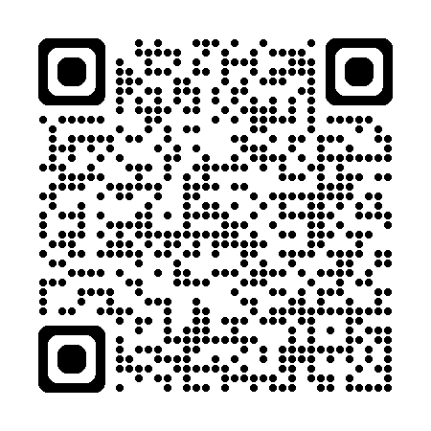
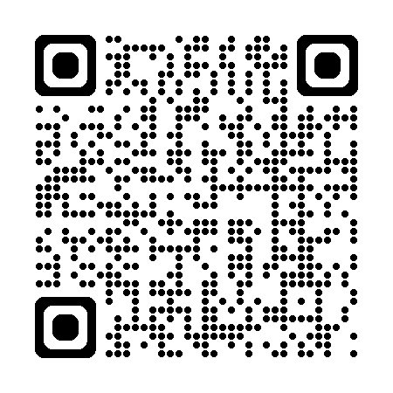
Want to know more?
New UK Sustainability Reporting Standards
Review of Mandatory TCFD reporting

